Slide 1
Ingegneria dei dati Lucene
Tommaso Teofili

Slide 2
What is Apache Lucene
Information Retrieval Java library
Other languages have wrapper libraries (e.g. for Python: PyLucene, lupyne, pyserini, etc.)
Open source
Apache License 2.0
Core component of many search engine technologies
Apache Solr
Elasticsearch

Slide 3
Production systems running on Lucene
Twitter
https://blog.twitter.com/engineering/en_us/topics/infrastructure/2020/reducing-search-indexing-latency-to-one-second
Amazon
https://aws.amazon.com/it/blogs/opensource/amazon-giving-back-apache-lucene/
Ingenuity Mars Helicopter
https://github.blog/2021-04-19-open-source-goes-to-mars/
Adobe
Apple
Wikimedia Foundation
...

Slide 4
Research leveraging Lucene
Yang, Peilin, Hui Fang, and Jimmy Lin. "Anserini: Enabling the use of Lucene for information retrieval research." Proceedings of the 40th International ACM SIGIR Conference on Research and Development in Information Retrieval. 2017.
Azzopardi, Leif, et al. "Lucene4IR: Developing information retrieval evaluation resources using Lucene." ACM SIGIR Forum. Vol. 50. No. 2. New York, NY, USA: ACM, 2017.
Uplavikar, Nitish, Bradley A. Malin, and Wei Jiang. "Lucene-P2: A Distributed Platform for Privacy-Preserving Text-based Search." IEEE Transactions on Dependable and Secure Computing (2020).
Roy, Dwaipayan, et al. "I-REX: A Lucene Plugin for EXplainable IR." Proceedings of the 28th ACM International Conference on Information and Knowledge Management. 2019.
....

Slide 5
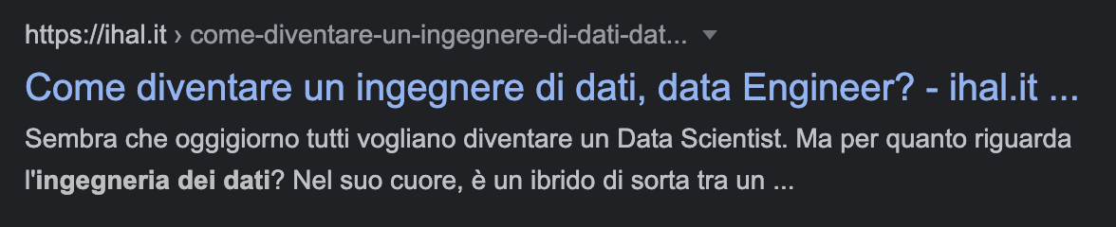

User perspective
Ingegneria dei dati
Query is executed
Search results are returned
Search engine

Slide 6
Architectural perspective - Search time
Come diventare un ingegnere dei dati, data Engineer? ...
Ingegneria dei dati
Curriculum Ingegneria dei dati - Sezione di ...
Query parsing
Ranking
Term
Term
Document
Document
Query
Search results
ingegneria
dati
Come diventare un ingegnere dei dati, data Engineer? ...
Curriculum Ingegneria dei dati - Sezione di ...
Posting list

Slide 7
Architectural perspective - Indexing time
Come diventare un ingegnere dei dati, data Engineer? ...
Text analysis pipeline
Document
ingegneria
dati
data
come
ingegnere
engineer
Posting list

Slide 8
Architectural perspective - Indexing time
Curriculum Ingegneria dei dati - Sezione di ...
Text analysis pipeline
Document
curriculum
dati
roma
ingegneria
sezione
tre
Posting list

Slide 9
Tutorial
Indexing
Define a Lucene index
Create Documents
Index documents
Searching
Open a Lucene index
Define a Query
Run a query
Ranking

Slide 10
Indexing

Slide 11
Define a Lucene index
A Lucene index is made up of files inside a directory on hard disk
Decide where to store the Lucene index
Path path = Paths.get(“/opt/lucene-index”);
Create a Lucene Directory for read/write access on a Lucene index
Directory directory = FSDirectory.open(path);

Slide 12
Lucene indexing
An IndexWriter gives you write access on a Lucene index
IndexWriterConfig config = new IndexWriterConfig();
IndexWriter writer = new IndexWriter(directory, config);
With an IndexWriter you can add Lucene Documents to the index
Document document1 = ...
writer.addDocument(document1);
Once all documents have been added, commit the changes
writer.commit();
You won’t see anything at search time if you don’t commit!
Lucene is append-only
No update()
Just delete() and add()

Slide 13
Creating Lucene Documents
Document → abstraction on unit to be indexed and retrieved
Field → a portion of a document with own syntax and semantics
Mapping 1 : 1 Field → Posting list
Document doc1 = new Document();

Slide 14
Creating Lucene Documents - Fields
Document → abstraction on unit to be indexed and retrieved
Field → a portion of a document with own syntax and semantics
Mapping 1 : 1 Field → Posting list
Document doc1 = new Document();
doc1.add(new Field("titolo", "Come diventare un ingegnere dei dati, Data Engineer?", …, ...));

Slide 15
Creating Lucene Documents - Fields
Document → abstraction on unit to be indexed and retrieved
Field → a portion of a document with own syntax and semantics
Mapping 1 : 1 Field → Posting list
Document doc1 = new Document();
doc1.add(new Field("titolo", "Come diventare un ingegnere dei dati, Data Engineer?", …, ...));
doc1.add(new Field("contenuto", "Sembra che oggigiorno tutti vogliano diventare un Data Scientist ...", …, ...));

Slide 16
Creating Lucene Documents TextFields vs StringFields
We want to process text in Fields according to specific semantics
We expect matches to happen at “word” level, not at entire string level
Querying “ingegneria dei dati” vs “Come diventare un ingegnere dei dati, Data Engineer?”

Slide 17
Creating Lucene Documents TextFields vs StringFields
We want to process text in Fields according to specific semantics
We expect matches to happen at “word” level, not at entire string level
Querying “ingegneria dei dati” vs “Come diventare un ingegnere dei dati, Data Engineer?”
doc1.add(new TextField("titolo", "Come diventare un ingegnere dei dati, Data Engineer?", ...));

Slide 18
Creating Lucene Documents TextFields vs StringFields
We want to process text in Fields according to specific semantics
We expect matches to happen at “word” level, not at entire string level
Querying “ingegneria dei dati” vs “Come diventare un ingegnere dei dati, Data Engineer?”
doc1.add(new TextField("titolo", "Come diventare un ingegnere dei dati, Data Engineer?", ...));
vs
doc1.add(new StringField("titolo", "Come diventare un ingegnere dei dati, Data Engineer?", ...));
StringField keeps text as it is

Slide 19
Creating Lucene Documents - Stored Fields
Document doc1 = new Document();
doc1.add(new TextField("titolo", "Come diventare un ingegnere dei dati, Data Engineer?", …, Field.Store.YES));
When a Field is Stored its string value is stored in the Lucene index and linked to the internal Document id
Set Field.Store.YES if you need to read that value at search time

Slide 20
Indexing Lucene Documents
Directory directory = FSDirectory.open(Paths.get("/opt/lucene-index"));
IndexWriter writer = new IndexWriter(directory, new IndexWriterConfig());
Document doc1 = new Document();
doc1.add(new TextField("titolo", "Come diventare un ingegnere dei dati, Data Engineer?", Field.Store.YES);
doc1.add(new TextField("contenuto", "Sembra che oggigiorno tutti vogliano diventare un Data Scientist ...", Field.Store.YES));
Document doc2 = new Document();
doc2.add(new TextField("titolo", "Curriculum Ingegneria dei Dati - Sezione di Informatica e Automazione", Field.Store.YES);
doc2.add(new TextField("contenuto", "Curriculum. Ingegneria dei Dati. Laurea Magistrale in Ingegneria Informatica ...", Field.Store.YES));
writer.addDocument(doc1); ← add Documents to be indexed
writer.addDocument(doc2);
writer.commit(); ← persist changes to the disk

Slide 21
Architectural perspective - Indexing time
Curriculum Ingegneria dei dati - Sezione di ...
Text analysis pipeline
We skipped this!
Document
curriculum
dati
roma
ingegneria
sezione
tre
Posting list

Slide 22
Lucene - Processing text for indexing
Need to define different processing options on a per Fields basis
“titolo” → keep case, no stopwords
“content” → stopwords, case insensitive

Slide 23
Lucene - Processing text for indexing
TextField allows us to define how we want text to be
Tokenized
Filtered and altered
Tokenizer → splits text into tokens (or terms) according to given semantics
WhitespaceTokenizer, CharTokenizer, ...
TokenFilter → filters out terms according to given semantics
LimitTokenCountFilter, LowerCaseFilter, …
Analyzer → Text processing abstraction
Tokenizer
(optional) ordered chain of TokenFilters

Slide 24
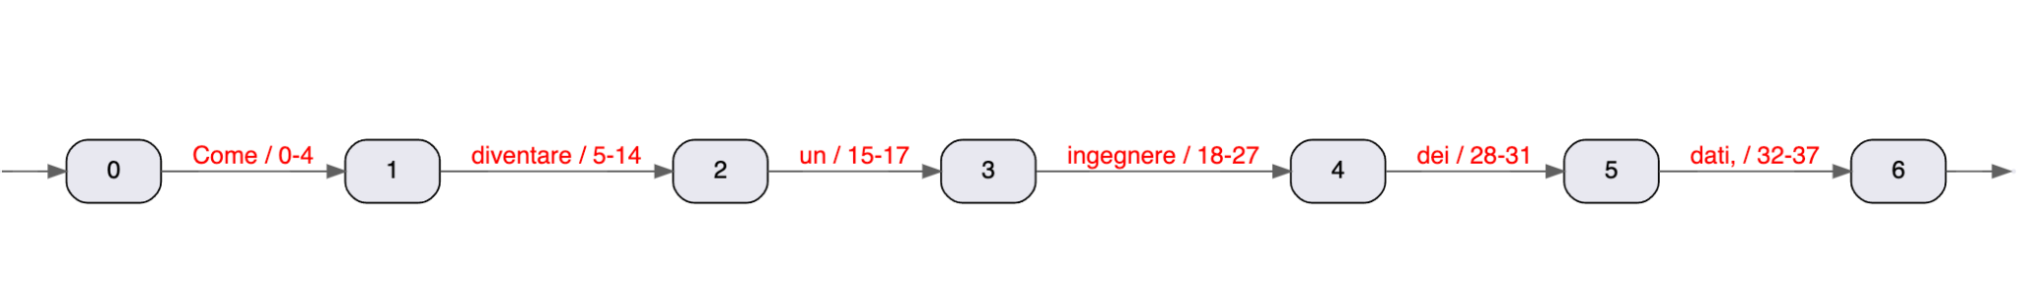
Lucene - Indexing Analyzers
Processing “Come diventare un ingegnere dei dati,”
WhitespaceAnalyzer (splits on whitespace char)
Analyzer a = CustomAnalyzer.builder()
.withTokenizer(WhitespaceTokenizerFactory.class)

Slide 25
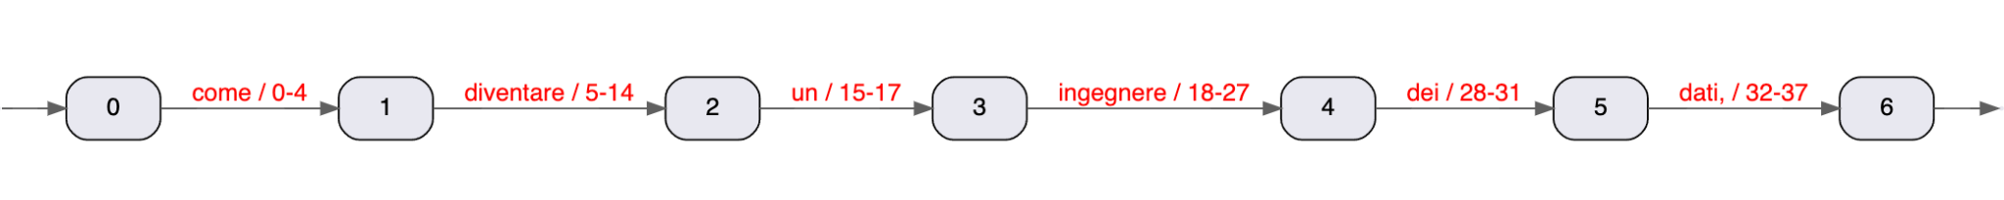
Lucene - Indexing Analyzers
Processing “Come diventare un ingegnere dei dati,”
WhitespaceAnalyzer (splits on whitespace char)
Lowercase tokens
Analyzer a = CustomAnalyzer.builder()
.withTokenizer(WhitespaceTokenizerFactory.class)
.addTokenFilter(LowerCaseFilterFactory.class) ← lowercase
.build();

Slide 26
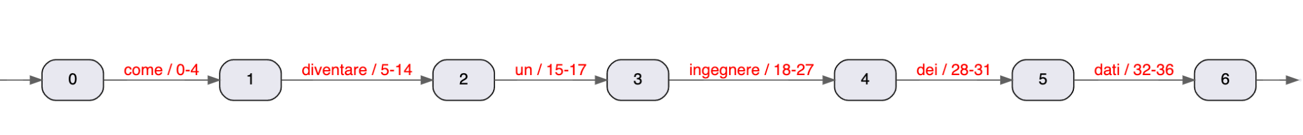
Lucene - Indexing Analyzers
Processing “Come diventare un ingegnere dei dati,”
WhitespaceAnalyzer (splits on whitespace char)
Lowercase tokens
Filter out word delimiters like , . -
Analyzer a = CustomAnalyzer.builder()
.withTokenizer(WhitespaceTokenizerFactory.class)
.addTokenFilter(LowerCaseFilterFactory.class)
.addTokenFilter(WordDelimiterGraphFilterFactory.class) ← filter our “word delimiters”
.build();

Slide 27
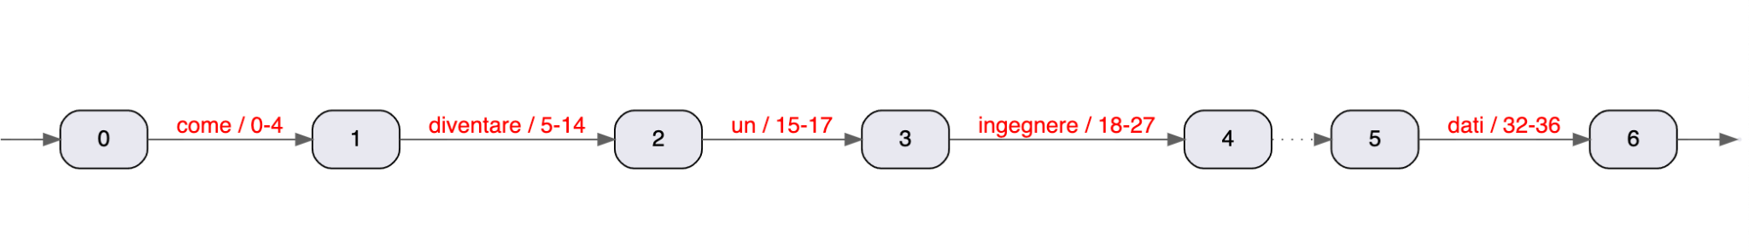
Lucene - Indexing Analyzers
Processing “Come diventare un ingegnere dei dati,”
StandardAnalyzer (splits based on Word Break rules from the Unicode Text Segmentation algorithm)
Stopword filter
CharArraySet stopWords = new CharArraySet(Arrays.asList("di", "a", "da", … "dei" ...), true);
Analyzer a = new StandardAnalyzer(stopWords);

Slide 28
Lucene - Indexing Analyzers
Many different pre-built options
WhitespaceAnalyzer
ClassicAnalyzer
StandardAnalyzer
ItalianAnalyzer
StopAnalyzer
KeywordAnalyzer
…
Freedom to define text processing pipeline
https://lucene.apache.org/core/8_10_0/core/org/apache/lucene/analysis/Analyzer.html

Slide 29
Lucene - Indexing Analyzers
Need to define different processing options on a per Fields basis
“titolo” → keep case, no stopwords, no word delimiters splitting
“content” → stopwords, case insensitive, word delimiter splitting
Define different Analyzers for each defined Field (plus a default one)
Map<String, Analyzer> perFieldAnalyzers = new HashMap<>();
CharArraySet stopWords = new CharArraySet(Arrays.asList("in", "dei", "di"), true);
perFieldAnalyzers.put("titolo", new WhitespaceAnalyzer());
perFieldAnalyzers.put("contenuto", new StandardAnalyzer(stopWords));
Analyzer analyzer = new PerFieldAnalyzerWrapper(new ItalianAnalyzer(), perFieldAnalyzers);

Slide 30
Indexing Lucene Documents
Path path = Paths.get("/opt/lucene-index");
Directory directory = FSDirectory.open(path);
IndexWriterConfig config = new IndexWriterConfig(perFieldAnaluzer); ← text processing semantics for indexing Fields defined here!
IndexWriter writer = new IndexWriter(directory, config);
Document doc1 = new Document();
...
Document doc2 = new Document();
...
writer.addDocument(doc1); ← add Documents to be indexed
writer.addDocument(doc2);
writer.commit(); ← persist changes to the disk

Slide 31
Indexing Documents - debugging
If you’re curious to read what’s actually inside your index use SimpleTextCodec
IndexWriterConfig config = new IndexWriterConfig(perFieldAnaluzer);
config.setCodec(new SimpleTextCodec());
Note that this doesn’t work retroactively (need to reindex)
Good for debugging only

Slide 32
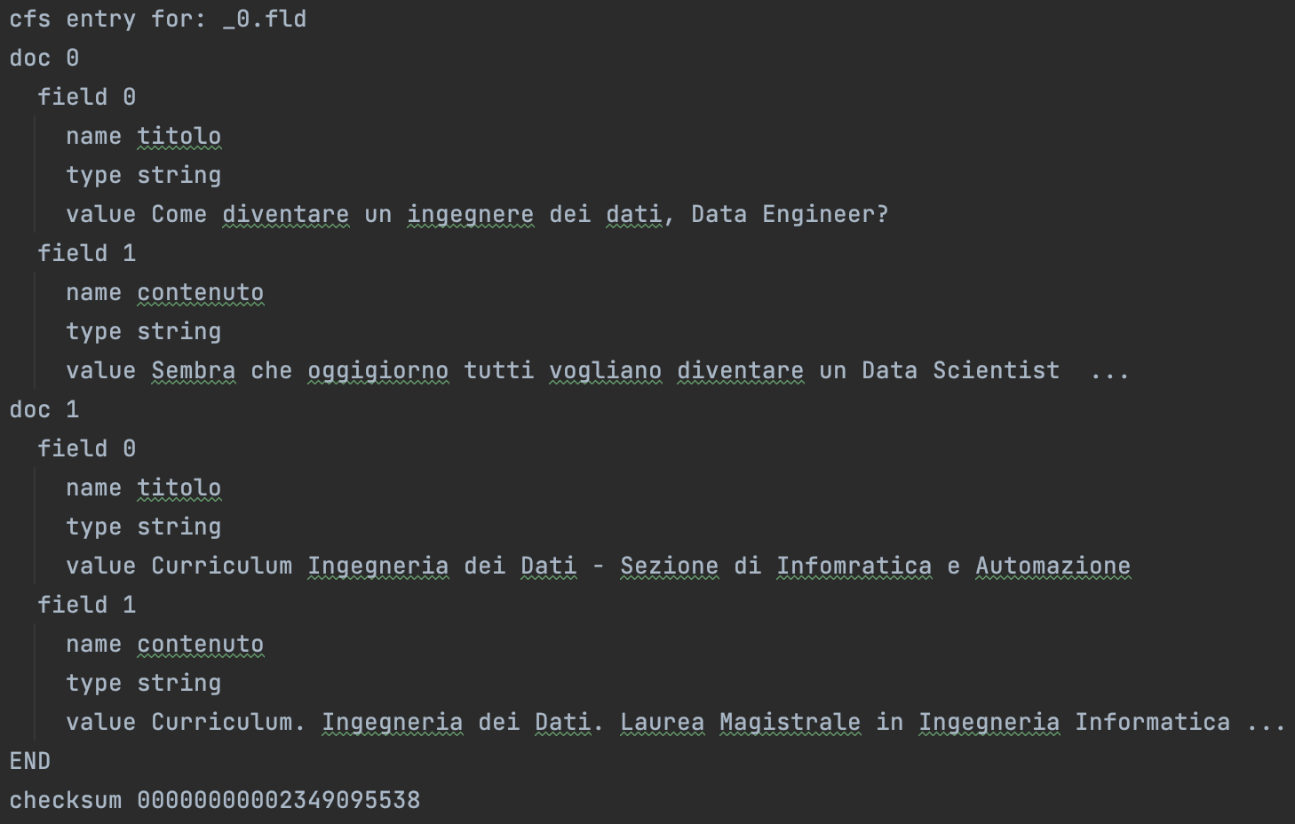
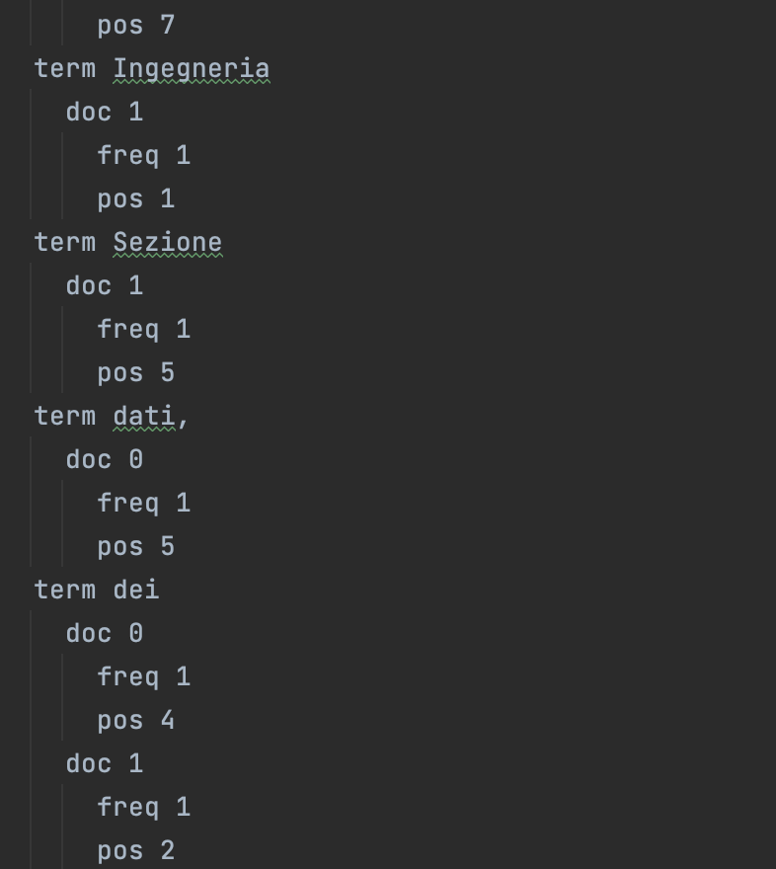
SimpleTextCodec

Slide 33
Searching

Slide 34
Open a Lucene index
Read access to a Directory via IndexReader
IndexReader reader = DirectoryReader.open(directory);
IndexSearcher lets you search on an IndexReader
IndexSearcher searcher = new IndexSearcher(reader);
IndexSearcher lets you run Query objects
Query query = …
searcher.search(query, topN);

Slide 35
Define a Query
MatchAllDocsQuery: A Query that matches all documents
E.g. just give me all documents in my Lucene index
Query allDocsQuery = new MatchAllDocsQuery();

Slide 36
Define a Query
TermQuery: A Query that matches documents containing a term
E.g. search for Documents containing the Term Ingegneria in Field titolo
TermQuery termQuery = new TermQuery(new Term("titolo", "Ingegneria"));

Slide 37
Define a Query
PhraseQuery: A Query that matches documents containing a particular sequence of terms
E.g. search for Documents containing the “phrase” data scientist in Field contenuto
PhraseQuery phraseQuery = new PhraseQuery.Builder()
.add(new Term("contenuto", "data"))
.add(new Term("contenuto", "scientist"))
.build();
Documents containing only data would not match
Documents containing only scientist would not match
Documents containing data and scientist differently arranged would not match (e.g. data for scientist)

Slide 38
Define a Query
Boolean queries
BooleanQuery: A Query that matches documents matching boolean combinations of other queries, e.g. TermQueries, PhraseQueries or other BooleanQueries.
E.g. search for Documents containing diventare AND ingegnere
E.g. search for Documents containing data OR scientist
E.g. search for Documents containing Ingegnere or data scientist
BooleanQuery booleanQuery = new BooleanQuery.Builder()
.add(new BooleanClause(termQuery, BooleanClause.Occur.SHOULD))
.add(new BooleanClause(phraseQuery, BooleanClause.Occur.SHOULD))
.build();

Slide 39
Define a Query
Using a QueryParser
Lucene has a QueryParser where you can define full text queries (like in a search bar)
QueryParser queryParser = new QueryParser(“titolo”, new WhitespaceAnalyzer());
Query query = parser.parse("+ingegneria dei +dati");
+ := required
- := prohibited
“foo bar” := phrase query
Terms without modifiers are considered optional

Slide 40
Run a Query
TopDocs collect search results
TopDocs hits = searcher.search(query, 10);
TopDocs report number of hits
Can browse search results via TopDocs.scoreDocs
ScoreDoc scoreDoc = hits.scoreDocs[i];

Slide 41
Run a Query
ScoreDoc reports internal Lucene document id (scoreDoc.doc) and ranking score (scoreDoc.score)
ScoreDoc objects do not contain actual Lucene Field values
Lazy loading
Need to fetch actual Document via
Document doc = searcher.doc(scoreDoc.doc);
Can fetch only stored field values via
String titolo = doc.get(“titolo”);
String contenuto = doc.get(“contenuto”);

Slide 42
Run a Query
IndexReader reader = DirectoryReader.open(directory); ← obtain read access to the inverted indexes
IndexSearcher searcher = new IndexSearcher(reader);
QueryParser parser = new QueryParser("titolo", new WhitespaceAnalyzer());
Query query = parser.parse(“+ingegneria dei +dati”); ← define the query
TopDocs hits = searcher.search(query, 10); ← search for the top 10 documents that match the query
for (int i = 0; i < hits.scoreDocs.length; i++) {
ScoreDoc scoreDoc = hits.scoreDocs[i];
Document doc = searcher.doc(scoreDoc.doc); ← fetch returned document
}

Slide 43
How Lucene ranks Documents
Lucene retrieves all the docs matching a Query and scores them in descending order according to a ranking function
The ranking function is implemented via a Similarity
Similarity is set within the IndexSearcher (before running a Query)
indexSearcher.setSimilarity(new ClassicSimilarity());

Slide 44
How Lucene ranks Documents - Similarities
ClassicSimilarity
TF-iDF scoring implementation
Gives higher score to Documents whose matching Terms have a higher term frequency
Term frequency: how many times a term appears “locally” in a given Document
Gives higher score to Documents whose matching Terms have a lower document frequency
Document frequency: how many times a term appears across all the documents

Slide 45
How Lucene ranks Documents - Similarities
BM25Similarity
Okapi BM25 Similarity
Probabilistic ranking framework introduced in 1984
Current Lucene default
Language model based Similarities
LMDirichletSimilarity
LMJelinekMercerSimilarity
…
Axiomatic Similarities
...

Slide 46
Disabling Lucene Ranking
What if I don’t need ranking ?
Use a Query which purposely discards ranking and always assigns constant scores
ConstantScoreQuery
Query originalQuery = …
Query notRankedQuery = new ConstantScoreQuery(originalQuery);
TopDocs results = searcher.search(notRankedQuery, topK);

Slide 47
Q&A

Slide 48
Resources
https://github.com/tteofili/lucenex
https://github.com/apache/lucene
https://lucene.apache.org
https://lucene.apache.org/core/8_10_0/index.html
https://github.com/Anant/awesome-lucene/blob/master/README.md

